Slide 1
Reinsurance Treaty Optimization
By Gopalakrishnan Kumar, MTech IIT-Bombay,
Freelance Data Science Consultant
LinkedIn: Profile Link : https://www.linkedin.com/in/gopalakrishnankumar-a73301110/
Github:https://www.github.com/Gopalakrishnan-Kumar/
Kaggle URL- https://www.kaggle.com/gopalkk2

Slide 2
Google Colab URL
https://colab.research.google.com/drive/1NMCccGMU1BgOhefqUnxhKot1huIQAIG_?usp=sharing

Slide 3
Introduction
The insurance industry operates under significant uncertainty due to the unpredictable nature of risk events such as natural disasters, accidents, and economic disruptions. Large insurance losses can threaten the financial stability of insurers if they are not properly managed. To mitigate these risks, insurers rely on reinsurance, a mechanism that transfers a portion of the insurer's risk to another insurance company known as the reinsurer.
Reinsurance treaties play a critical role in protecting insurers from catastrophic losses while enabling them to maintain solvency and capital adequacy. One of the most commonly used forms of reinsurance is excess-of-loss reinsurance, where the insurer retains losses up to a predefined retention limit and transfers the remaining loss to the reinsurer.

Slide 4
Introduction
The purpose of this project is to develop a data-driven framework for reinsurance treaty optimization using Python-based analytics and visualization techniques. By simulating insurance loss distributions and applying reinsurance structures, the study evaluates how losses are distributed between the insurer and reinsurer.
The analysis includes multiple visualization techniques such as histograms, bar charts, stacked bar charts, and combined stacked bar charts to provide insights into loss distribution, regional risk concentration, and the effectiveness of reinsurance treaties.

Slide 5
Objectives of the Study
The key objectives of this project are:
To simulate insurance loss distributions using statistical modeling techniques.
To analyze how losses vary across different geographic regions.
To implement an excess-of-loss reinsurance treaty structure.
To evaluate the distribution of retained and ceded losses.
To visualize insurance portfolio risk using advanced data visualization techniques.

Slide 6
Dataset Description
The dataset used in this project is a synthetic insurance loss dataset created using Python simulation techniques. The dataset represents a portfolio of 1000 insurance policies distributed across multiple regions.
Key Variables
Variable | Description
Policy ID | Unique identifier for each insurance policy
Region | Geographic region where the policyholder resides
Loss Amount | Total loss incurred from an insurance claim
Insurer Retained Loss | Portion of loss retained by the insurer
Reinsurer Ceded Loss | Portion of loss transferred to the reinsurer

Slide 7
Dataset Description
The losses are simulated using a lognormal distribution, which is commonly used in insurance modeling because it accurately represents real-world loss behavior where most losses are small but rare catastrophic losses are extremely large.

Slide 8
Methodology
4.1 Loss Simulation
Insurance losses were generated using a lognormal probability distribution. This distribution captures the skewed nature of insurance claims, where most claims are moderate while a few claims are extremely large.
Mathematically:
Loss ~ Lognormal(μ, σ)
where:
μ represents the mean of the log-transformed losses
σ represents the volatility of losses

Slide 9
Methodology
4.2 Reinsurance Treaty Structure
The project applies an excess-of-loss reinsurance treaty, which consists of two main parameters:
Retention Limit
The retention limit represents the maximum loss amount the insurer agrees to retain before reinsurance coverage begins.
Example:
Retention Limit = $500,000

Slide 10
Methodology
Reinsurance Coverage Limit
The reinsurance coverage limit defines the maximum amount that the reinsurer will cover beyond the retention limit.
Example:
Reinsurance Limit = $2,000,000
Loss Allocation Formula
For each claim:
Insurer Retained Loss = min(Loss Amount, Retention Limit)
Reinsurer Ceded Loss = max(min(Loss Amount − Retention Limit, Reinsurance Limit), 0)
This structure ensures that:
Small losses are absorbed by the insurer.
Large catastrophic losses are partially transferred to the reinsurer.

Slide 11
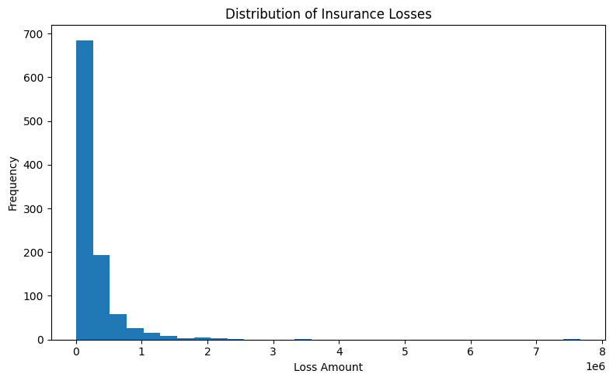
Data Visualization

Slide 12
Data Visualization and Analysis
5.1 Histogram Analysis
The histogram plot visualizes the distribution of insurance losses across the portfolio.
Key observations include:
Most losses fall within the lower claim ranges.
A small number of claims represent extremely large catastrophic losses.
The distribution is right-skewed, which is typical for insurance loss data.
This insight highlights the importance of reinsurance for managing catastrophic tail risk.

Slide 13
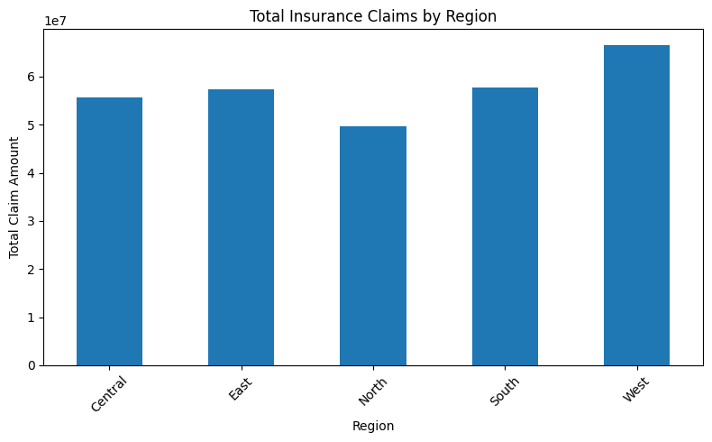
Data Visualization

Slide 14
Data Visualization and Analysis
5.2 Bar Chart Analysis
The bar chart displays total claim amounts across different regions.
This visualization helps identify regions with higher insurance risk exposure. Regions with taller bars represent areas where claims occur more frequently or where loss severity is higher.
Such information can assist insurers in:
Adjusting underwriting strategies
Increasing premiums in high-risk regions
Purchasing additional reinsurance coverage

Slide 15
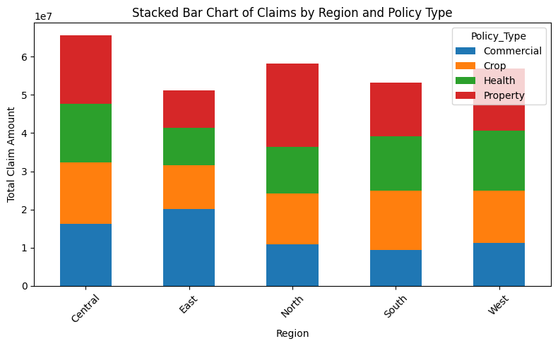
Data Visualization

Slide 16
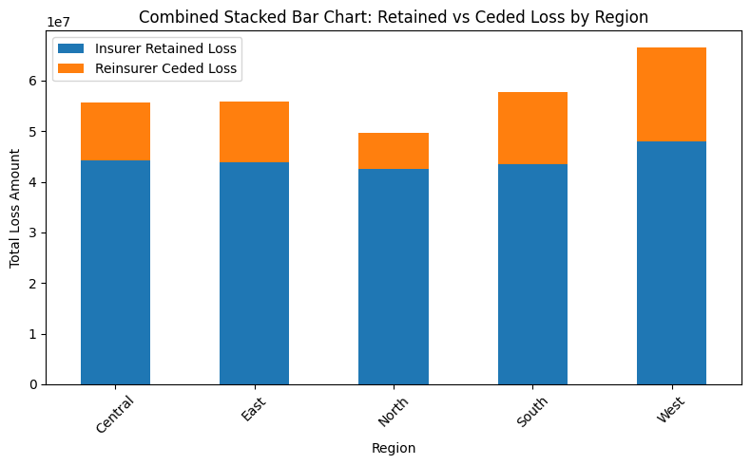
Data Visualization

Slide 17
Data Visualization and Analysis
5.3 Stacked Bar Chart Analysis
The stacked bar chart breaks down claims by region and policy type.
This analysis provides insights into which insurance categories generate the highest losses.
For example:
Property insurance may dominate losses in urban regions.
Crop insurance may generate higher losses in rural regions.
Understanding this distribution allows insurers to better manage their portfolio risk.

Slide 18
Business Applications
The reinsurance treaty optimization model provides several practical applications in the insurance industry.
Risk Transfer Management
Reinsurance allows insurers to transfer part of their financial risk to reinsurers, thereby protecting themselves from catastrophic events.
Capital Adequacy and Solvency
Regulatory frameworks require insurers to maintain adequate capital reserves. Optimized reinsurance treaties reduce volatility and help insurers maintain solvency.

Slide 19
Business Applications
Portfolio Risk Diversification
By analyzing risk exposure across regions and policy types, insurers can diversify their portfolios to reduce concentration risk.
Pricing Optimization
Understanding loss distributions helps insurers adjust premium pricing to ensure profitability.
Strategic Reinsurance Purchasing
Data-driven insights enable insurers to determine the optimal level of reinsurance coverage.

Slide 20
Key Insights
Insurance losses follow a highly skewed distribution with
significant catastrophic tail risk.
A small percentage of claims account for the majority of total losses.
Reinsurance significantly reduces insurer exposure to extreme loss events.
Geographic regions vary significantly in their
loss concentration and claim severity.
Excess-of-loss treaties are effective for catastrophe risk management.
Portfolio diversification across regions reduces overall risk volatility.
Retention limits must be carefully chosen to balance
risk retention and reinsurance costs.
Data analytics improves reinsurance treaty design and pricing strategies.
Visualization techniques help insurers understand complex risk patterns.

Slide 21
Conclusion
Reinsurance is a critical component of modern insurance risk management. As insurance portfolios grow and catastrophic risks become more frequent, insurers must rely on advanced analytics to optimize their reinsurance strategies.
This project demonstrates how Python-based data simulation and visualization techniques can be used to analyze insurance loss distributions and evaluate the effectiveness of reinsurance treaties.
By modeling loss distributions and applying excess-of-loss reinsurance structures, insurers can better understand how risks are distributed between themselves and reinsurers. The visualization techniques used in this study provide valuable insights into portfolio risk concentration and catastrophe exposure.
Ultimately, data-driven reinsurance treaty optimization enables insurers to reduce financial volatility, improve capital management, and enhance long-term sustainability in an increasingly uncertain risk environment.

